Slide 1
Computer Architecture
The Fundamental
Course Number : TTH2D3
CLO : 1
Week : 1
CLO#1 Student have the knowledge to explain microprocessor system
[C2] Understand the history of microprocessor and microcontroller
[C2] Understand the architecture of computer system
[C2] Understand the design of minimum system for microcontroller

Slide 2
Why do we need to take this course?

Slide 3
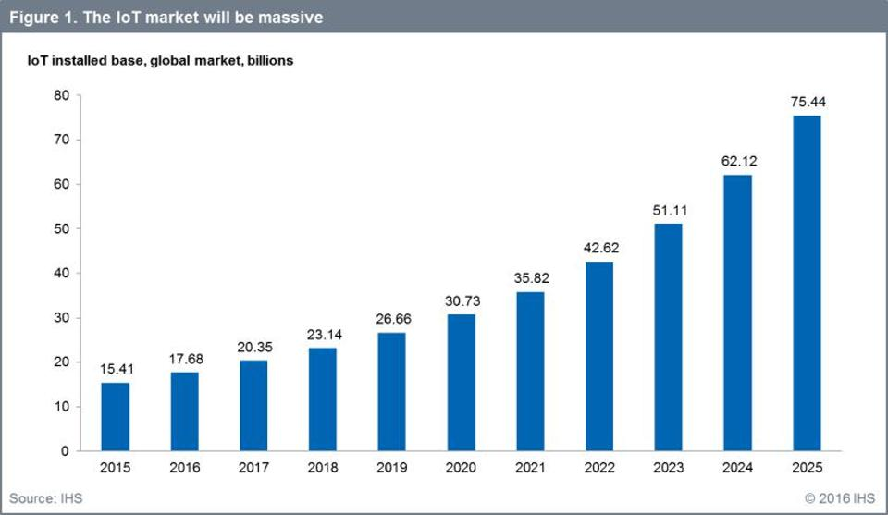
IoT Growth Rate
Source: Forbes

Slide 4
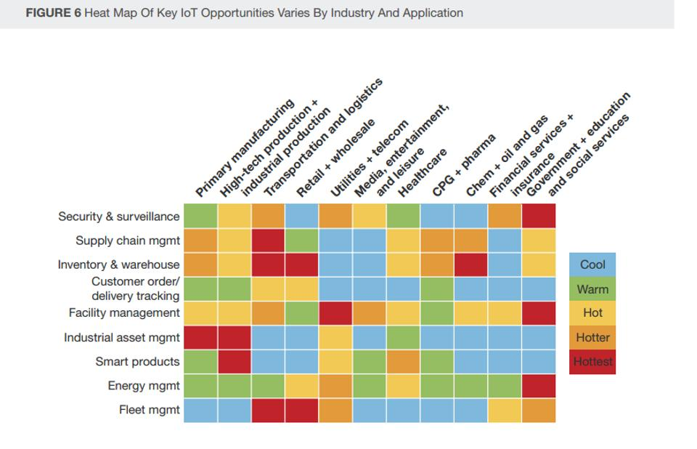
Heat Map of IoT by Industry and Application
Source: Forbes

Slide 5
Why do we need to take this course?
Because everything will be connected through The Internet, and it starts with what you will learn in this course, i.e. microcontroller.

Slide 6
What is Organization and how it differ with Architecture?
Computer Organization
describes each unit’s functionality, like input, storage, process, and output.
Computer Architecture
describes the interconnection between units and how they work together, including hardware and software.

Slide 7
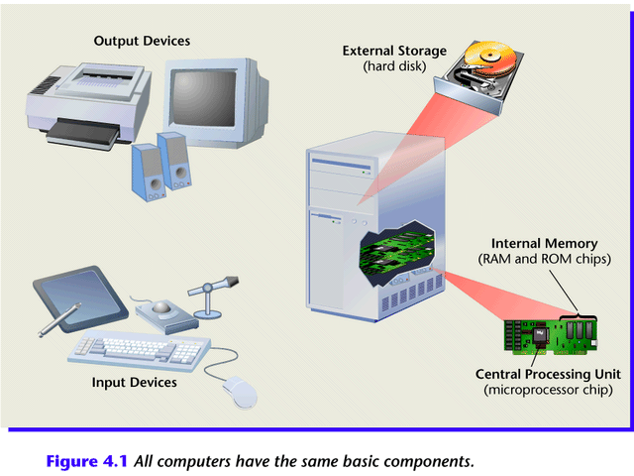
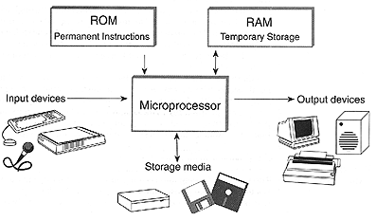
Computer System Hardware

Slide 8
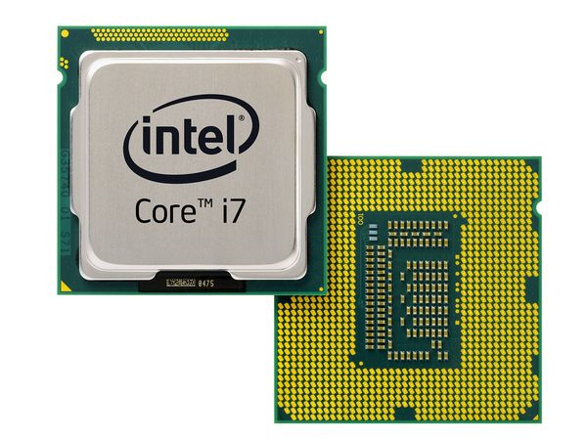
Microprocessor
The Fundamental

Slide 9
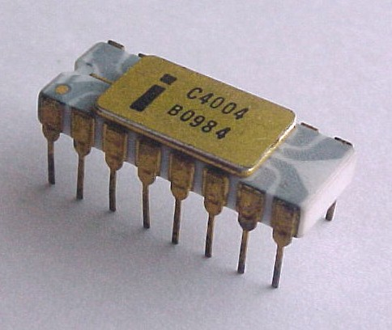
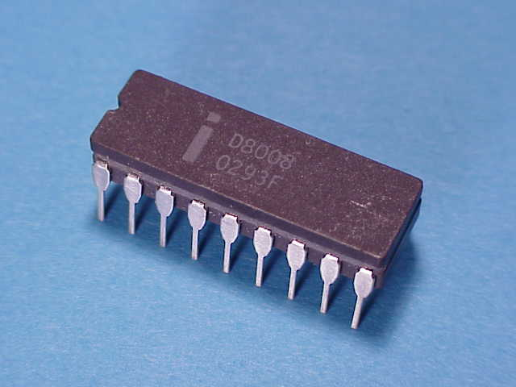
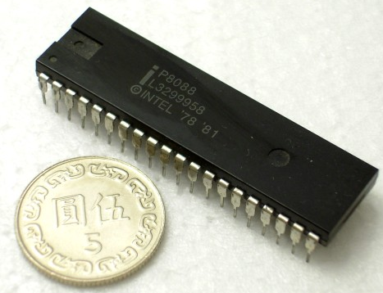
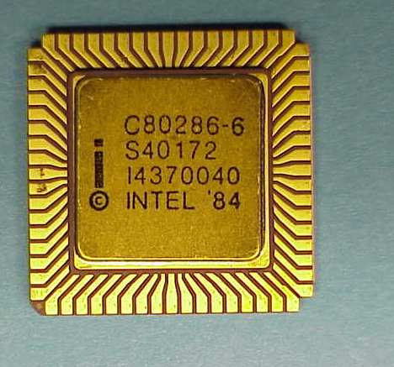
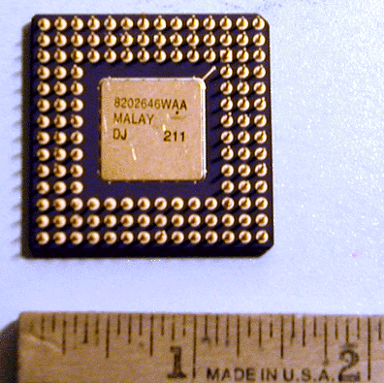
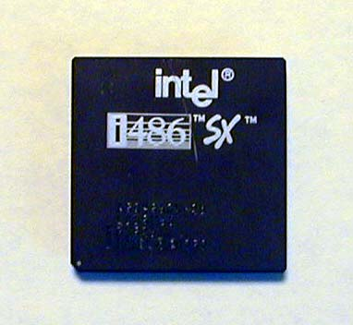
Microprocessor: Historical Review (1/3)
2300 transistor
29000 transistor
29000 transistor
Intel 4004 (1969)
Intel 8008 (1972)
Intel 8088 (1981)
134000 transistor
275000
transistor
1,2 million transistor
Intel 386 (1985)
Intel 286 (1982)
Intel 486 (1989)

Slide 10
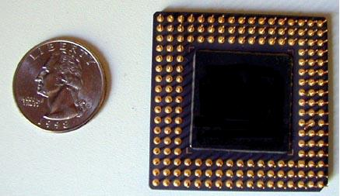
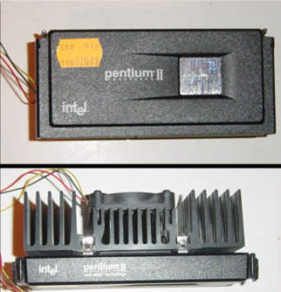
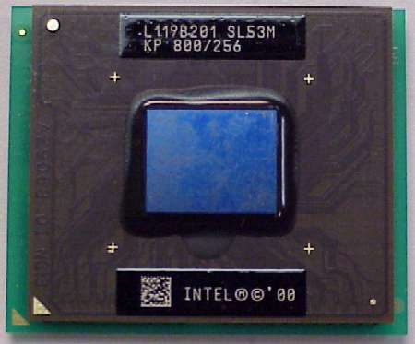
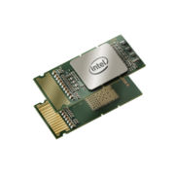
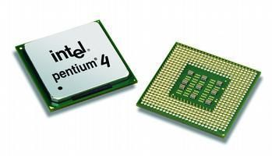
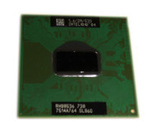
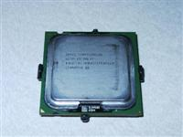
Microprocessor: Historical Review (2/3)
Intel P-II (1997)
Intel 586 (1993)
Intel P-III (1999)
Intel Pentium-D (2005)
Intel P4 (2000)
Intel Pentium-M (2003)
Intel Itanium (2006)

Slide 11
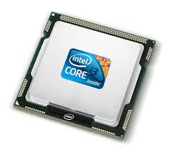
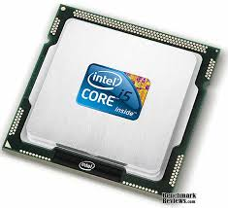
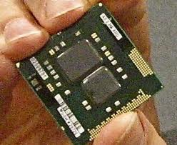
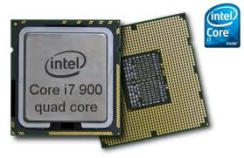
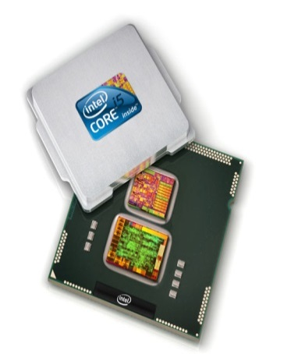
Microprocessor: Historical Review (3/3)

Slide 12
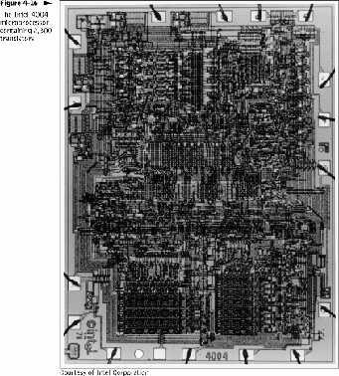
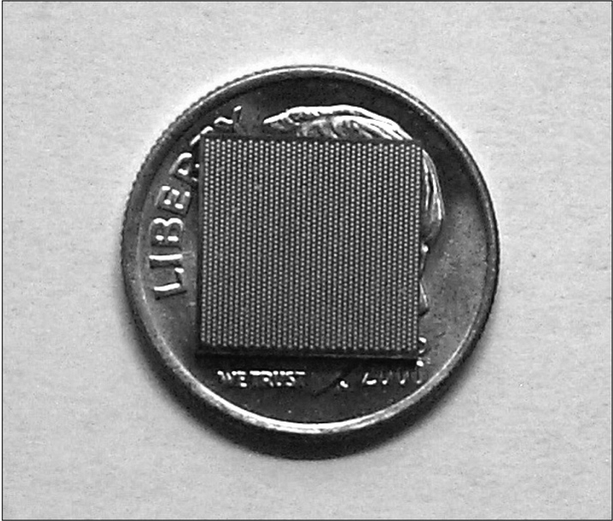
Microprocessor Complexity
Intel 4004 with 2300 transistors (1969)
Intel Itanium with 330 million transistors (2005)

Slide 13
Microprocessor Complexity (in Detail)
Microprocessor Type | Year | Speed | Word | Transistors | MIPS
4004 | 1969 | 108 kHz | 4 bit | 2300 | 0.06
8008 | 1972 | 200 kHz | 8 bit | 3500 | 0.06
8080 | 1974 | 2 MHz | 8 bit | 6000 | 0.64
8086 | 1978 | 4.47 MHz | 16 bit | 29000 | 0.66
8088 | 1981 | 4.47 MHz | 16 bit | 29000 | 0.75
80286 | 1982 | 12 MHz | 16 bit | 134000 | 2.66
80386 | 1985 | 16-33 MHz | 32 bit | 275000 | 4
80486 (i486) | 1989 | 20-100 MHz | 32 bit | 1.2 million | 70
80586 (Pentium) | 1993 | 75-200 MHz | 32 bit | 3.3 million | 126-203
Pentium Pro | 1995 | 150-200 MHz | 32 bit | 5.5 million | 300
Pentium MMX | 1997 | 166-233 MHz | 32 bit | 4.5 million
Pentium II | 1997 | 233-450 MHz | 32 bit | 7.5 million
Pentium III | 1999 | 450-933 MHz | 32 bit | 9.5 million
Itanium | 2000 | 1 GHz | 64 bit | 15 million | 1200

Slide 14
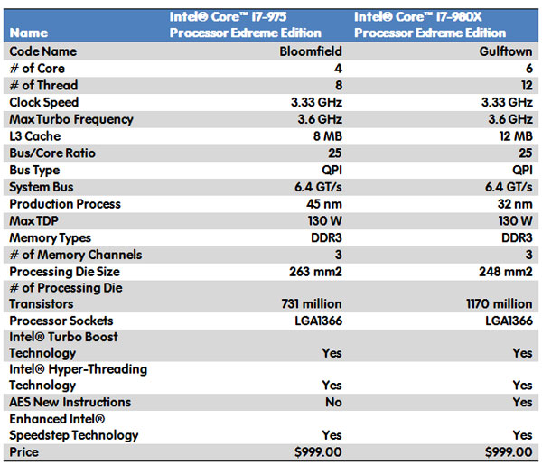
Intel i7

Slide 15
Definition
Microprocessor is a:
LSI/VLSI (Very Large Scale Integration), designed to process information, any information.
Multipurpose or General Purpose LSI/VLSI
Sometimes (incorrectly) named CPU (Central Processing Unit)
Fabricated on a die chip

Slide 16
Definition
Microprocessor System is a:
System consists of at least 1 microprocessor and a support system
Support system may include:
Memory unit
Input unit
Output unit

Slide 17
Computer System Architecture
#1
#2
#3
Input
uP
uP
Output
Input
uP
Output
#4
#5
#6
Input
uP
uP
Output
Input
uP
Output
Memory
Memory
Memory

Slide 18
Support System
Memory
Static RAM, Dynamic RAM, ROM, EPROM, Flash Disk, Hard Disk
Input
Keyboard, Mouse, Touch Pad, Scanner, ADC
Output
Monitor, Speaker, VR, Printer, DAC

Slide 19
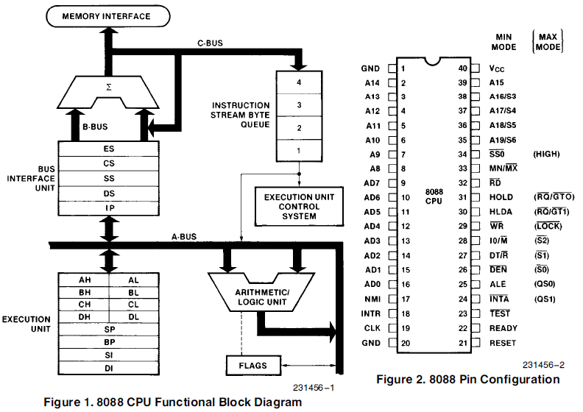
Inside the Microprocessor
ALU
Register
Control Unit
Bus

Slide 20
Inside the Microprocessor
ALU, Arithmetic and Logic Unit responsible for calculation
Register, a special type (very fast) of memory responsible for storing instruction, data, address, and status
Control Unit responsible to control the works
Bus responsible for transferring signal (control, data, address)

Slide 21
How it Works?
2
C = A + B
2
Data Register
A
B
3
C
CU
1
Instruction Register
ADD A,B → C
ALU

Slide 22
Microprocessor: Basic functionalities
Able to locate where the instruction and data resides
Able to fetch the instruction and data from memory
Able to store instruction and data in register
Able to decode and understand the instruction
Able to execute the instruction
Able to manage all process in a proper sequence

Slide 23
Memory
Why do we need memory? to store data and instruction
What is memory hierarchy? a hierarchy of memory types
What are memory types? internal vs. external, accessibility, media
data
address 1
data
address 2
data
address 3
data
address 4

Slide 24
Hierarchy Memory
Register
BIGGER CAPACITY
FASTER SPEED
HIGHER PRICE
is a way to balance capacity, speed, and price
Cache
(SRAM)
Main Memory
(DRAM)
Secondary Memory
(Hard Disk)

Slide 25
Memory Types
Internal vs. External
Register, RAM, Hard Disk, CD/DVD
Accessibility
ROM (Read Only Memory), PROM (Programmable ROM), EPROM (Erasable PROM), EEPROM (Electrically EPROM)
RAM (Random Access Memory), SRAM (Static RAM), DRAM (Dynamic RAM)
Media
Electric charge, Optic, Magnetic

Slide 26
Interaction between Microprocessor and Memory
There are 2 types of interaction:
READ operation (retrieve), where microprocessor retrieves data from memory
WRITE operation (store), where microprocessor stores data into memory

Slide 27
How Microprocessor READs from Memory?
Microprocessor prepares and outputs the address of data that need to be retrieved for processing
Microprocessor sends a READ signal to memory
After receiving a READ signal, memory locate the data based on given address
Memory provides the data into data bus

Slide 28
How Microprocessor WRITEs into Memory?
Microprocessor prepares and outputs the address of data that need to be stored in memory
Microprocessor provides data into data bus
Microprocessor sends a WRITE signal to memory
After receiving a WRITE signal, memory read the data bus and stores the data using given address

Slide 29
Machine Instruction
The Fundamental

Slide 30
Machine Instruction Type
Data Transfer, ex: MOV, PUSH, POP
Arithmetic and Logic, ex: ADD, SUB, AND, OR, SHL
Control, ex: JMP, JZ

Slide 31
How Microprocessor RUNS an instruction?
Instruction Fetch (IF) is where microprocessor fetch the instruction from memory
Instruction Decode (DE) is where the microprocessor decode the instruction to understand what needs to be done
Execution (EX) is where te microprocessor execute the instruction
Instruction Fetch
Instruction Decode
Execution

Slide 32
Input and Output
Is an interface unit to communicate with outside the system’s world
Input unit receives data and in many cases also transforms signal from outside world (example, ADC Analog to Digital Converter)
Output unit delivers data and in many cases also transforms the data into specific signal (example, DAC Digital to Analog Converter)

Slide 33
Clock
Clock: is a digital periodic and independent signal, delivered to all units for synchronization
Clock is generated using crystal oscillator with specific frequency

Slide 34
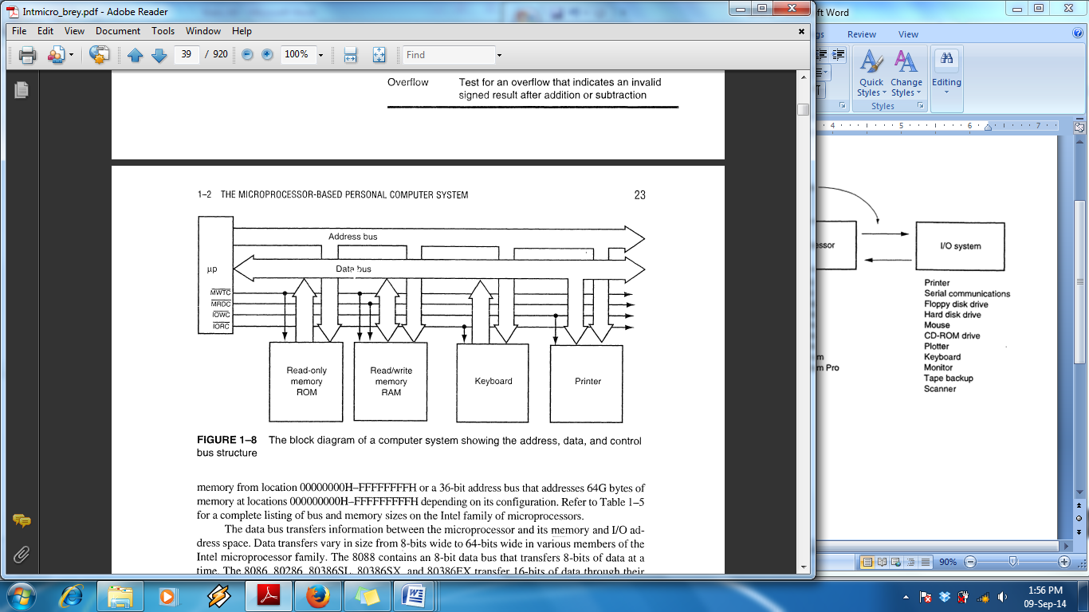
Bus System
There are 3 types of bus:
Data bus
Address bus
Control bus

Slide 35
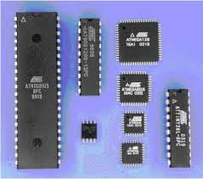
Microcontroller
The Fundamental

Slide 36
What is the difference between Microprocessor and Microcontroller?
Microcontroller is a single chip CPU that already consists of:
Processor (ALU + Unit Control)
Internal Memory RAM
Input / Output
Timer
Interrupt Control
Microcontroller is designed for a specific purpose, which makes it only applicable for 1 domain

Slide 37
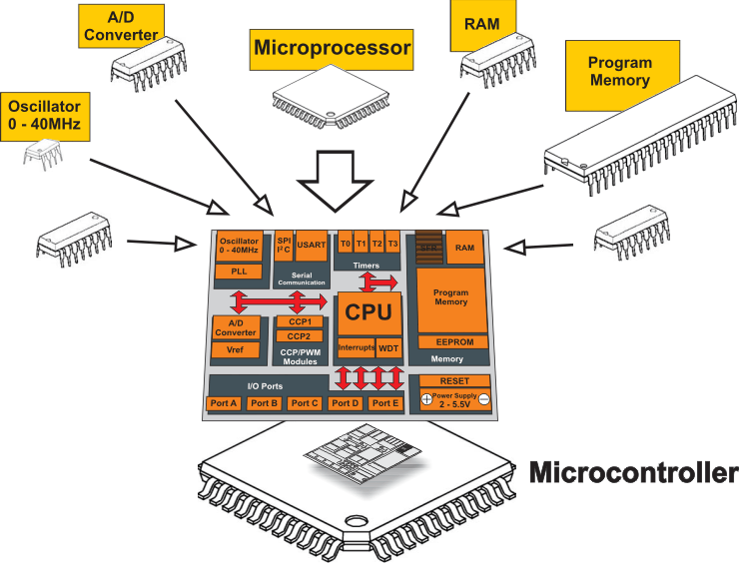
Microcontroller

Slide 38
Atmel Microcontroller
To be fully functional, a microcontroller needs:
Power suply
Clock generator
Power Reset

Slide 39
AT89CXX
Data Bus (8 bit) for transferring data from or to AT89CXX
Address Bus (16 bit) for:
indicating the address of data in memory
indicating which I/O that want to be connected
Control Bus for delivering signal to other peripherals, such as memory and I/O
+5 V
AT89C
Data Bus
Data Bus
Address Bus
Address Bus
Control Bus
Control Bus
Gound

Slide 40
See you on next class

